Slide 1
PROJECT IS802
Department of Information Science and Engineering
Malnad College of Engineering-Hassan
Title: Web Application for Coffee Shop (Scoopy’s Cafe)
Under the guidance of:
Mr.Chandrashekhar.H.S
Assistant Professor, ISE
Presented By:
Chandan.H.R
Deepak.H.M
Deepu.K.B
Sumith.D.B

Slide 2
AGENDA
Introduction
Literature Survey
Problem Statement
Objectives
Platforms and Tools
System Requirement Specifications
Implementation
Design
Testing
User Manual
Conclusion
Future Scope
References

Slide 3
SECTION 1

Slide 4
INTRODUCTION
What is Web Development?
Web development is the work involved in developing a Website for the Internet (World Wide Web) or an Intranet (a private network).
It can range from developing a simple single static page of plain text to complex web applications, electronic businesses, and social network services.
There are three kinds of Web developer specialization: front-end developer, back-end developer, and full-stack developer.
It refers to developing and maintaining web pages, including bits and pieces of concepts like web design, web programming, web publishing, and database management.

Slide 5

Introduction to JavaScript
JavaScript is a cross-platform, object-oriented scripting language used to make web pages interactive
There are also more advanced server side versions of JavaScript such as Node.js, which allow you to add more functionality to a website than downloading files (such as real time collaboration between multiple computers).
Client-side JavaScript extends the core language by supplying objects to control a browser and its Document Object Model (DOM).
Server-side JavaScript extends the core language by supplying objects relevant to running JavaScript on a server.
Many library developers provide both development and production versions of their libraries.

Slide 6

Introduction to ReactJS
ReactJS is a declarative, efficient, and flexible JavaScript library for building reusable UI components. It is an open-source, component-based front end library responsible only for the view layer of the application.
Today, most of the websites are built using MVC (model view controller) architecture.
In MVC architecture, React denotes 'V' which stands for view, whereas the architecture is provided by the Redux or Flux.
A ReactJS application is made up of multiple components, each component responsible for outputting a small, reusable piece of HTML code. The components are the heart of all React applications.
ReactJS uses virtual DOM based mechanism to fill data in HTML DOM. The virtual DOM works fast as it only changes individual DOM elements instead of reloading complete DOM every time.

Slide 7
13%
Web development is also a rapidly expanding industry. Between now and 2028, the employment of web developers is expected to grow by 13 percent.

Slide 8
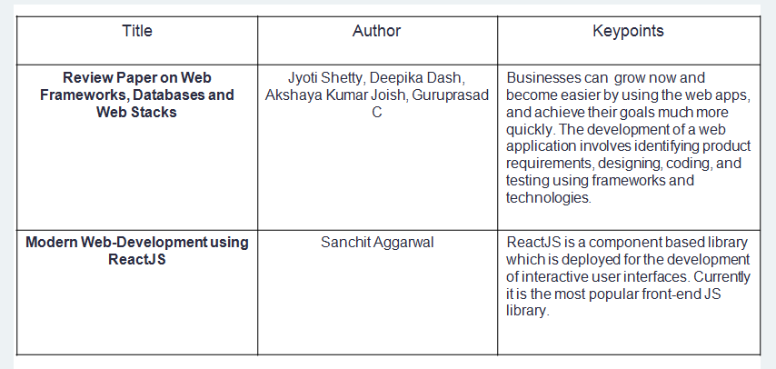
Literature Survey

Slide 9
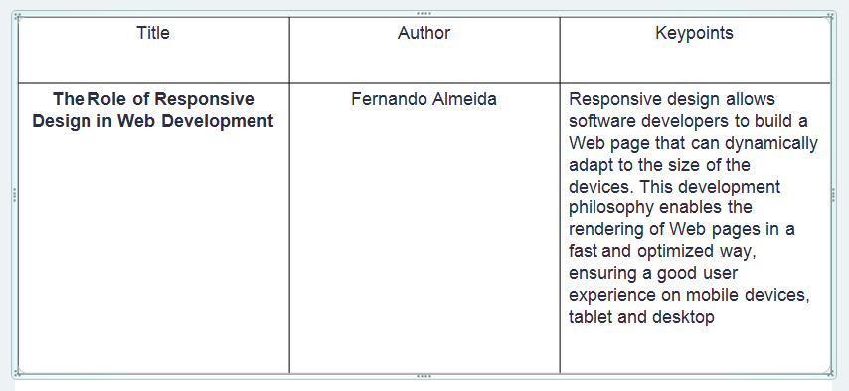
Literature Survey

Slide 10
SECTION 2

Slide 11
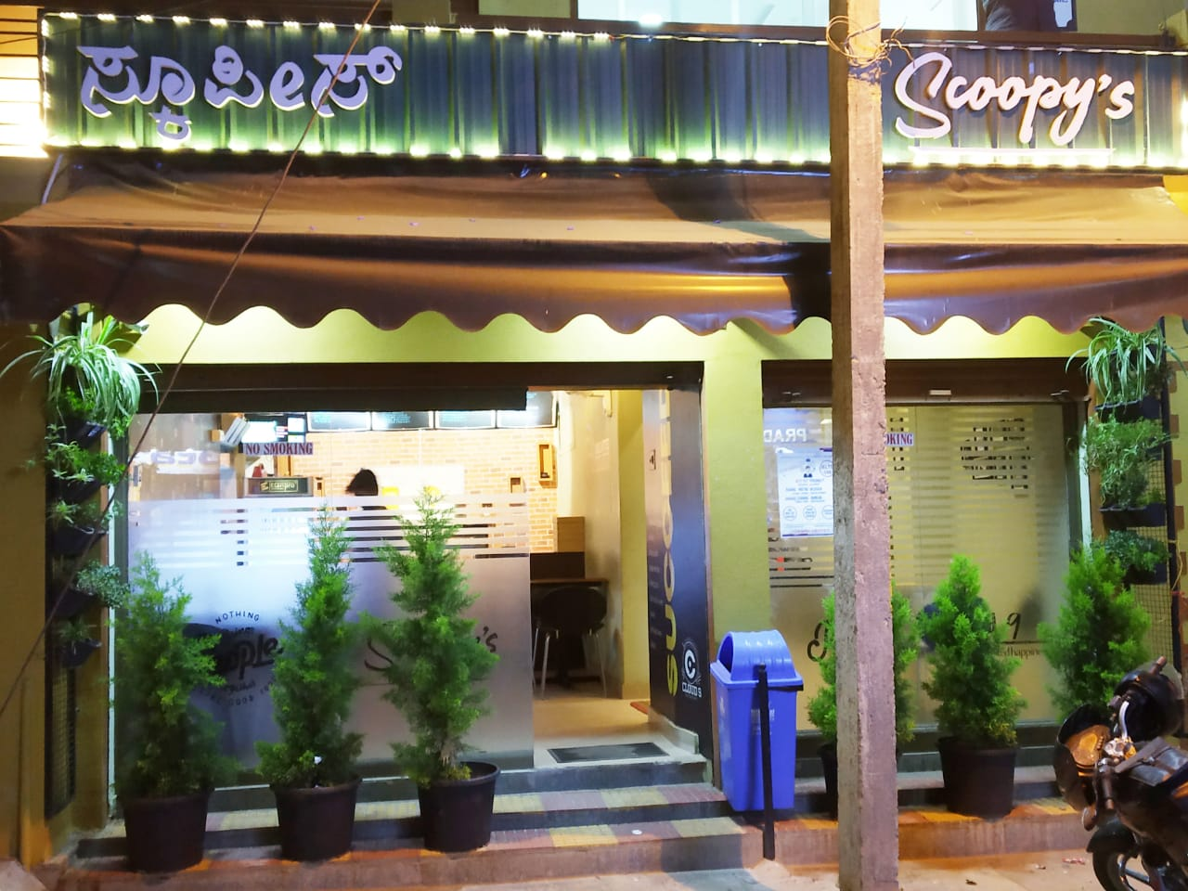
Problem Statement
To build a Web Application for a local coffee shop in the city. It aims for the betterment of the business and the application provides good interaction between the Customers and the Café by ordering food online.
Our Client:
SCOOPY’s Cafe
10th Cross, Shankar mutt Road ,
Hassan.
Ph: 8277322858

Slide 12

Objectives
The main objective of our web application is to manage the details of Food Item, Category, Customer, Order, Confirm Order. It manages all the information about Food Item, Payment, Confirm Order, Food Item. The project is totally built at administrative end and thus only the administrator is guaranteed the access. The purpose of the project is to build an application program to reduce the manual work for managing the Food Item, Category, Payment, Customer. It tracks all the details about the Customer, Order, Confirm Order.
THE CUSTOMER SHALL BE ABLE TO,
Launch web app in his mobile device.
Know about the cafe.
Check out the menu in the cafe.
Include food items of his choice to his cart.
Place the order.
Make payments using cash/cards.

Slide 13
SECTION 3

Slide 14


Platforms and Tools
Visual Studio Code - Visual Studio Code is a freeware source-code editor made by Microsoft for Windows, Linux and macOS. Features include support for debugging, syntax highlighting, intelligent code completion, snippets, code refactoring, and embedded Git.
Gatsby - It is a React-based open-source framework for creating webapps and Jamstack delivery platform for building amazingly fast, secure, and beautiful websites.

Slide 15


Platforms and Tools
NETLIFY
Netlify is a San Francisco-based cloud computing company that offers hosting and serverless backend services for web applications and static websites.
The company provides hosting for websites whose source files are stored in the version control system Git and then generated into static web content files served
via a Content Delivery Network.
SNIPCART
Snipcart is a shopping cart developers can easily integrate into any website in minutes.
Snipcart's focus is on quick site integration, so a lot of complex store functionality is handled by a hosted service.
The Snipcart Plugin relies on Craft and Snipcart's REST API to more tightly integrate the two and reduce your setup and development time without sacrificing the ability to have a full-featured store

Slide 16


Platforms and Tools
CONTENTFUL
Contentful is the platform where you can update the content of your website, a mobile app or any other platform that displays content.
We save you the time and hassle to create your own backend to manage the content, and provide many tools which make it easier to actually generate a website or app.
Contentful is an efficient tool for creating and managing your content online, either alone or in team.
GIT
Take Concurrent Versions System (CVS) as an example of what not to do; if in doubt, make the exact opposite decision.
Support a distributed, BitKeeper-like workflow.
Include very strong safeguards against corruption, either accidental or malicious.

Slide 17

Platforms and Tools
GITHUB
GitHub is a provider of Internet hosting for software development and version control using Git. It offers the distributed version control and source code management (SCM) functionality of Git, plus its own features.
It provides access control and several collaboration features such as bug tracking, feature requests, task management, continuous integration and wikis for every project.
. Free GitHub accounts are commonly used to host open-source projects.

Slide 18
System Requirements Specification
Functional Requirements
THE CUSTOMER SHALL BE ABLE TO,
Launch web app in his mobile device.
Know about the cafe.
Check out the menu in the cafe.
Include food items of his choice to his cart.
Place the order.
Make payments using cash/cards.
Non- Functional Requirements
Reliability
Consistency
Integrity
Usability
Performance
Fault Tolerant

Slide 19
System Requirements Specification
Software Requirements
▪ A Smartphone with Android version 5 and above.
▪ Active internet connection.
▪ A web browser to launch the web app.
▪ A PC with Windows 7 and above.
Hardware Requirements
▪ RAM: 3GB and above.
▪ Camera to scan the QR code.
▪ A PC with processor Intel® Core i3 and above.

Slide 20
SECTION 4

Slide 21
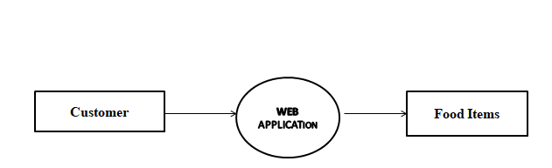
Data Flow Diagrams
Data Flow Diagrams show the flow of data from external entities into the system, and from one process to another within the system.
Level-0-DFD

Slide 22
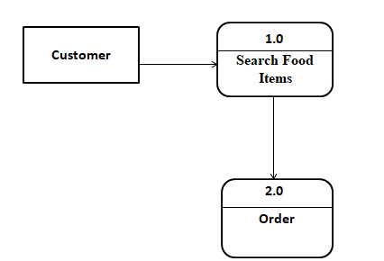
Data Flow Diagrams
Level-1-DFD

Slide 23
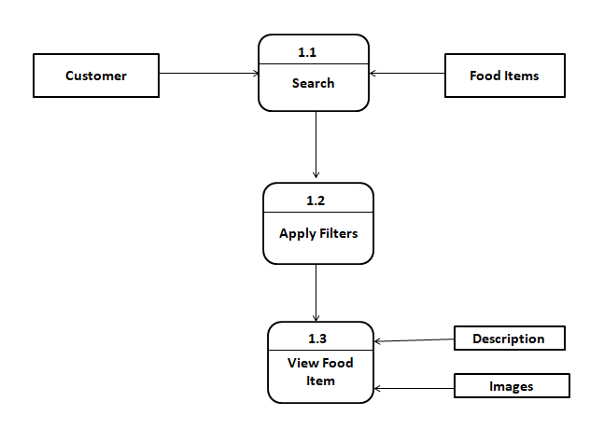
Data Flow Diagrams
Level-2-DFD

Slide 24
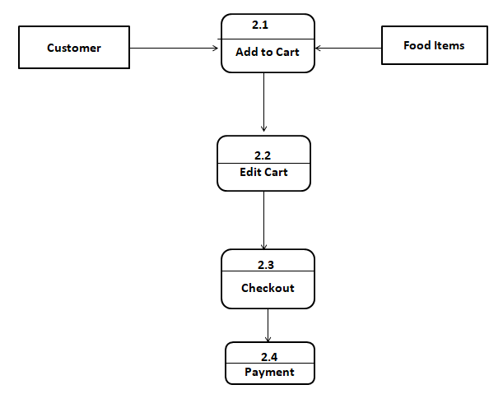
Data Flow Diagrams
Level-2-DFD

Slide 25
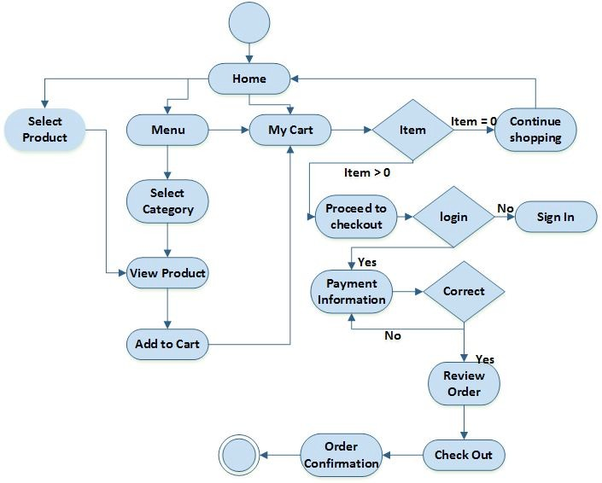
ACTIVITY DIAGRAM

Slide 26
SECTION 5

Slide 27
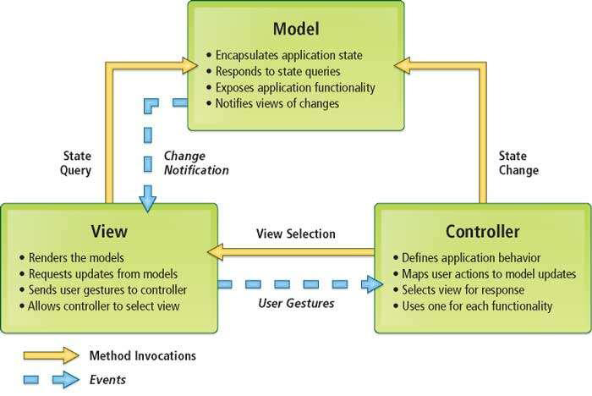
Implementation
Methodology
MVC

Slide 28
Implementation
Functional Modules
• Home Page: Contains the overview of Café with WhatsApp Quick Chat. It also has developer’s contact and Social Media Handles of the Café.
• Gallery Page: Carousel of beautiful and attractive inside/outside images of the Café.
• About Us Page: Contains Owner’s information such as Address, Phone Number and Google Co-ordinates. It also has Establishment Overview.
• Menu Page: All food items are embedded here with their Description, Images and Price. It allows adding food items to the cart with number of quantities.
• Reach Us Page: It has a form with First Name, Last Name, Email and Message. All fields are mandatory and these can never be empty.
• My Cart: All food items added in Menu are reflected here with number of quantities and total amount. Once cart is finalized, we can proceed to checkout and enter the credentials and choose cash/card payments. Once payment is successful, order is placed and the invoice is mailed to Customer’s Email ID.

Slide 29
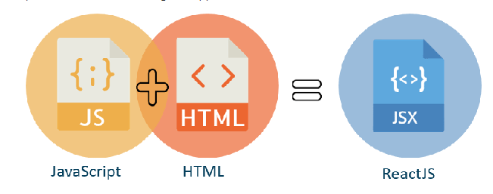
Implementation
Client Side Programming Language: ReactJS
Implementation of Functions:
JavaScript Syntax Extension
JSX is a syntax extension to JavaScript. It is used with React to describe what the user interface should look like.
By using JSX, we can write HTML structures in the same file that contains JavaScript code.
This makes the code easier to understand and debug, as it avoids the usage of complex JavaScript DOM structures.

Slide 30

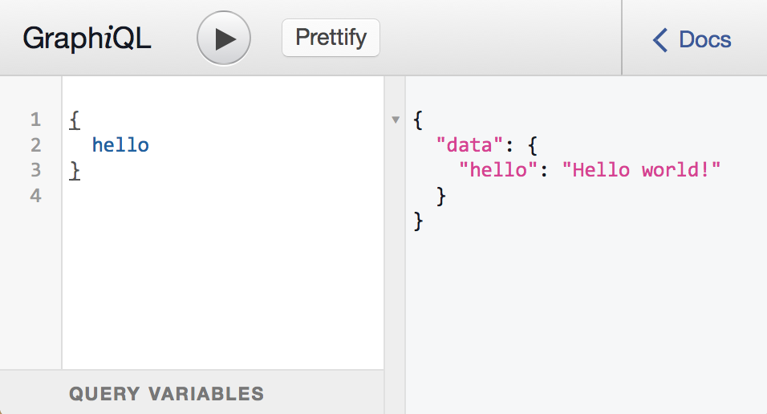
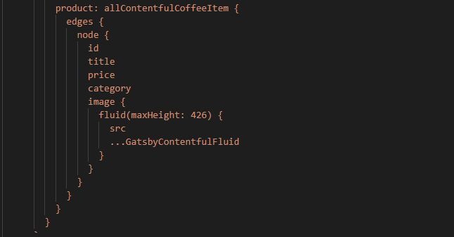
Implementation
Implementation of Functions:
GraphQL – Declarative Query Language
GraphQL is a query language for APIs and a runtime for fulfilling those queries with your existing data.

Slide 31
SECTION 6

Slide 32
Testing
Test Case | Expected Output
Feedback Form fields shall not be empty | SUCCESS
Customer Login with credentials | SUCCESS
Checkout with items in cart | SUCCESS
Payment details shall not be empty | SUCCESS
Feedback Form fields are empty | ERROR
Payment failed, no invoice | SUCCESS
Payment successful, invoice is mailed | SUCCESS
WhatsApp icon redirects to Café chat | SUCCESS
Checkout without items in cart | ERROR
Clicking Café location image, redirects to Google Maps | SUCCESS
Scanning QR code and acquire URL | SUCCESS
On Clicking handle bar, Nav bar is popped | SUCCESS
If no items in Contentful, Menu is empty | SUCCESS
Test Cases and Results

Slide 33
SECTION 7

Slide 34
User Manual
Installation/Launching the Application
Step-1: Open the camera to scan the QR code in your mobile
Suppose using a laptop, enter the URL in your Web Browser
Step-2: Launch the website prompted by the scanner
Step-3: Browse the website and view the menu present on that particular day
Step-4: Add food items to your cart and view it anytime
Step-5: You can also get in touch with Café Owner through WhatsApp present on the website
Step-6: Feel free to sneak into Café info, Gallery, Feedback and ways to contact the Café
Step-7: Once the cart is finalized, place your order by entering the personal details and choosing the card/cash payment
Step-8: Once the payment is successful, your order is placed and you receive the invoice to your email
Step-9: Your food is served to your table!!

Slide 35
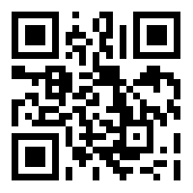
QR Code
Customers can scan this QR code and launch the website using the URL prompted.

Slide 36
SECTION 8

Slide 37
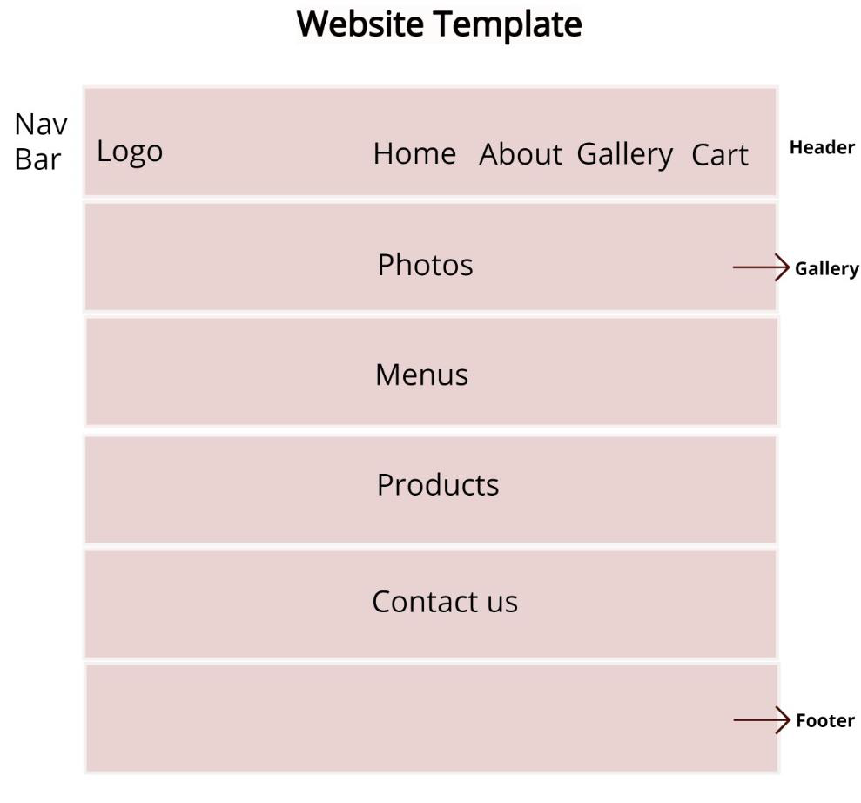
Snapshots
User Interface Design is concerned with the dialogue between a user and the computer.
Home Page Layout

Slide 38
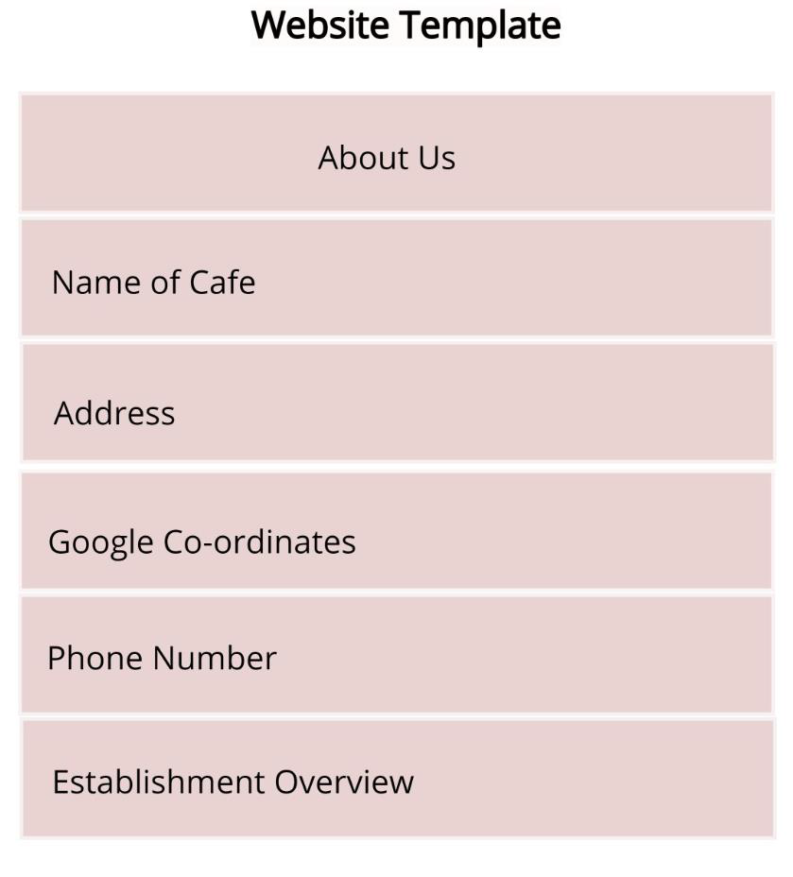
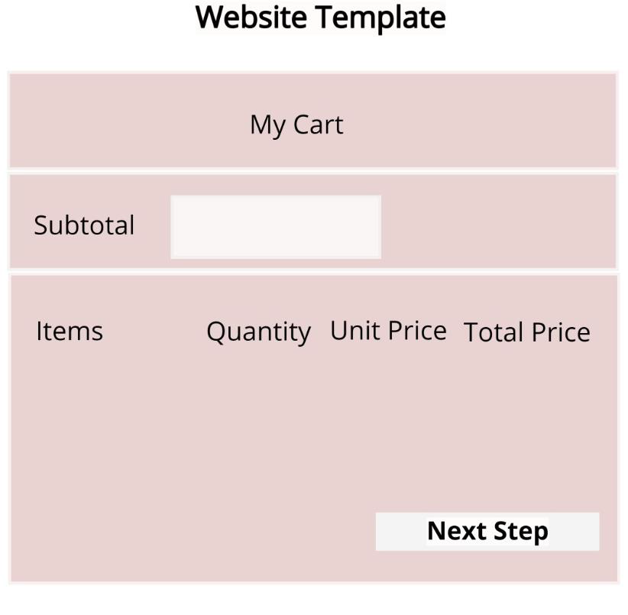
Snapshots
About Us Page Layout
My Cart Layout

Slide 39
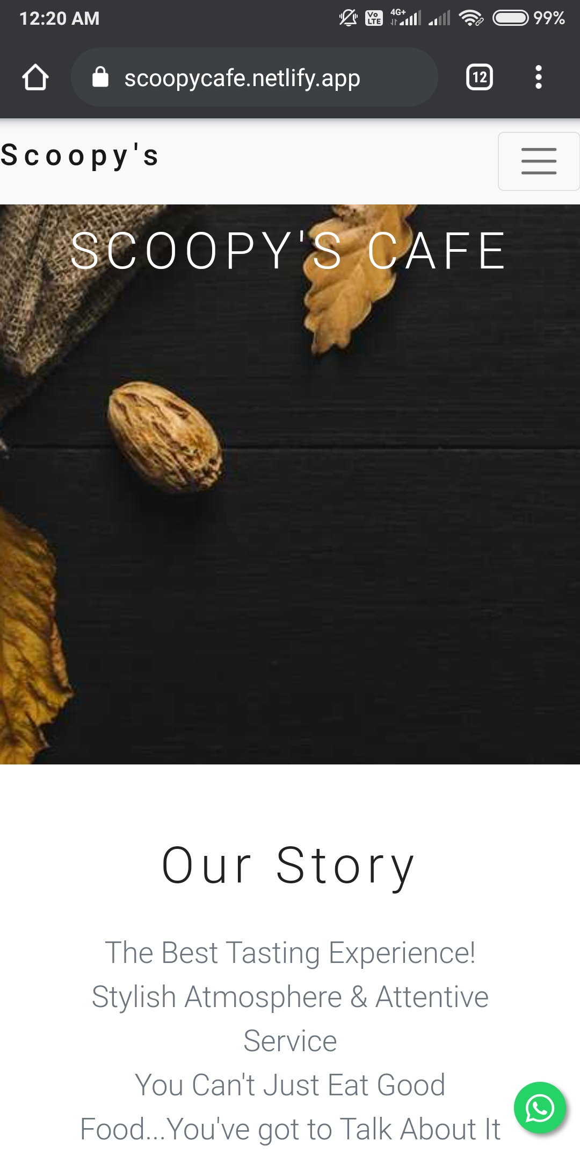
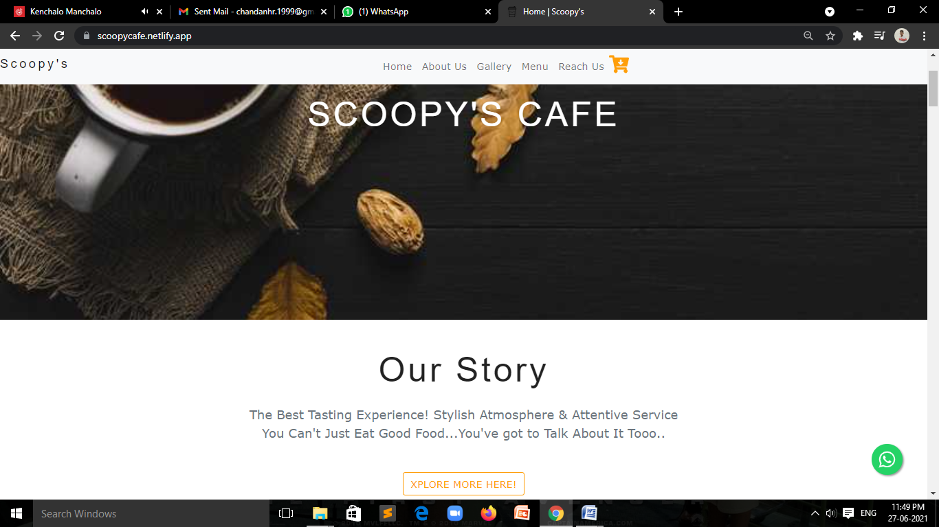
Snapshots

Slide 40
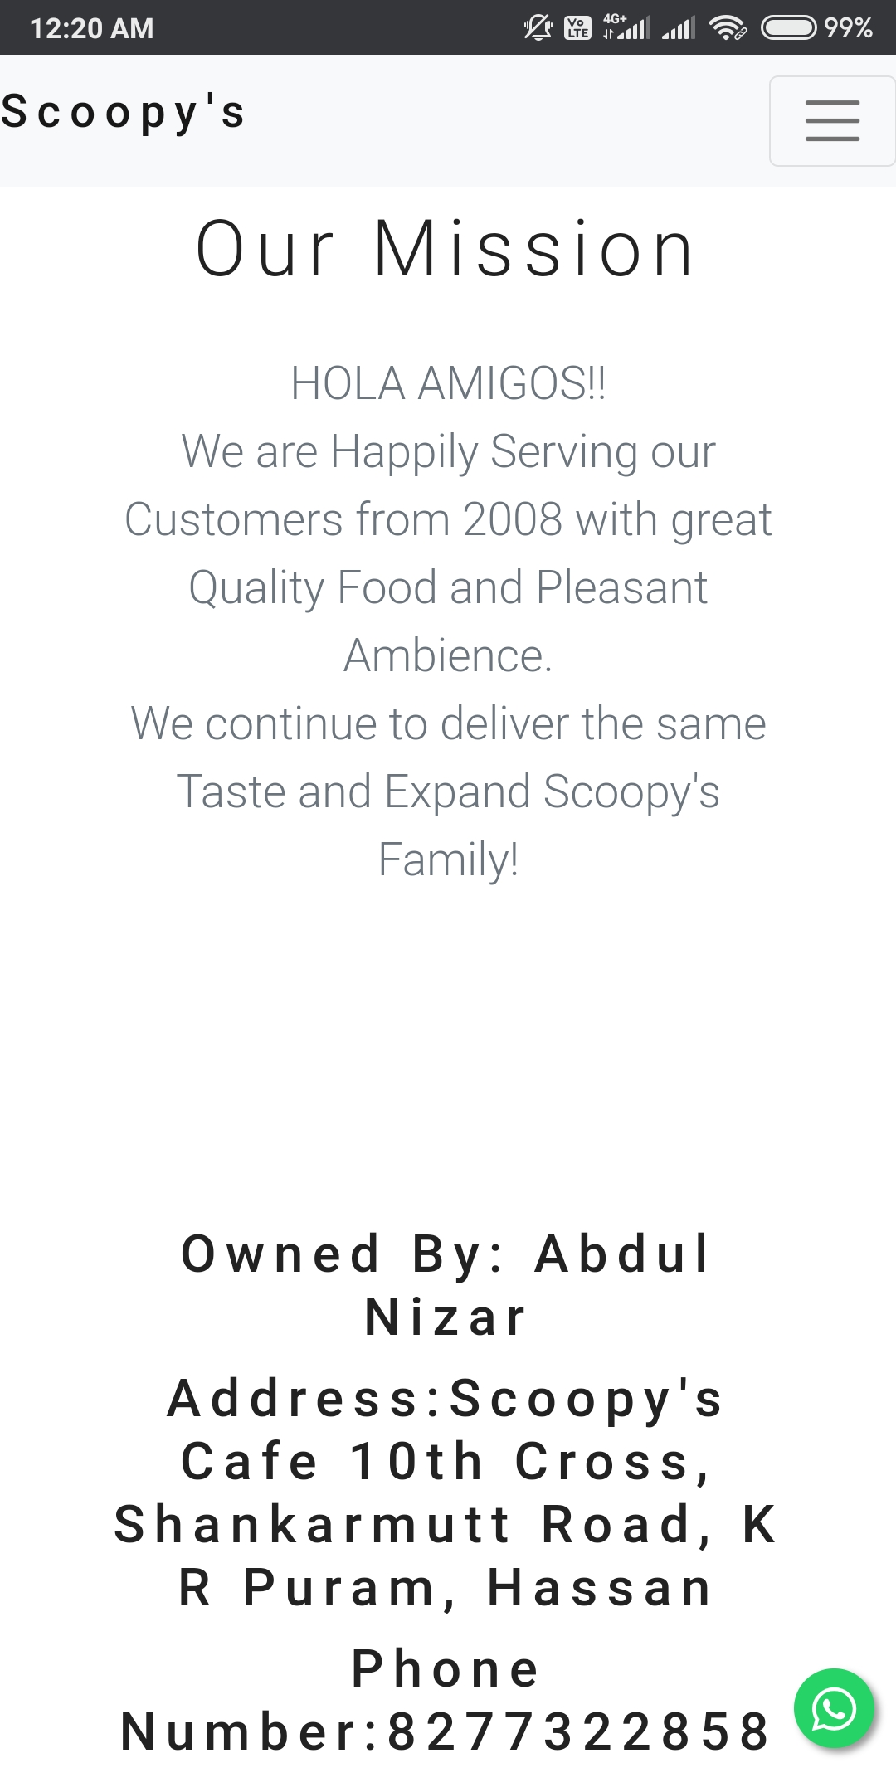
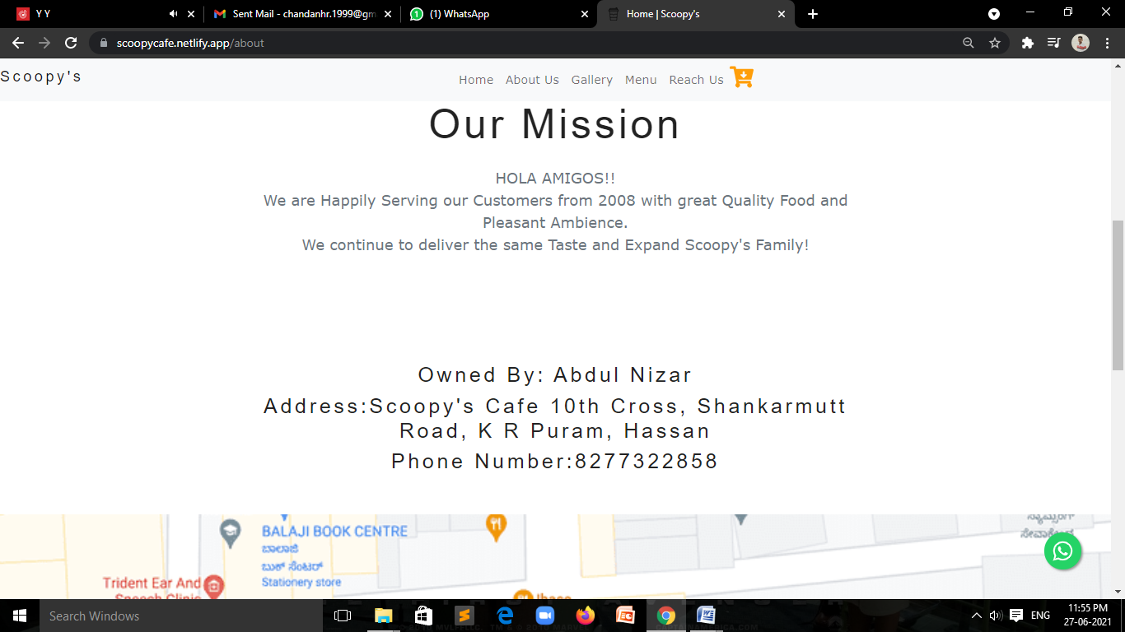
Snapshots

Slide 41
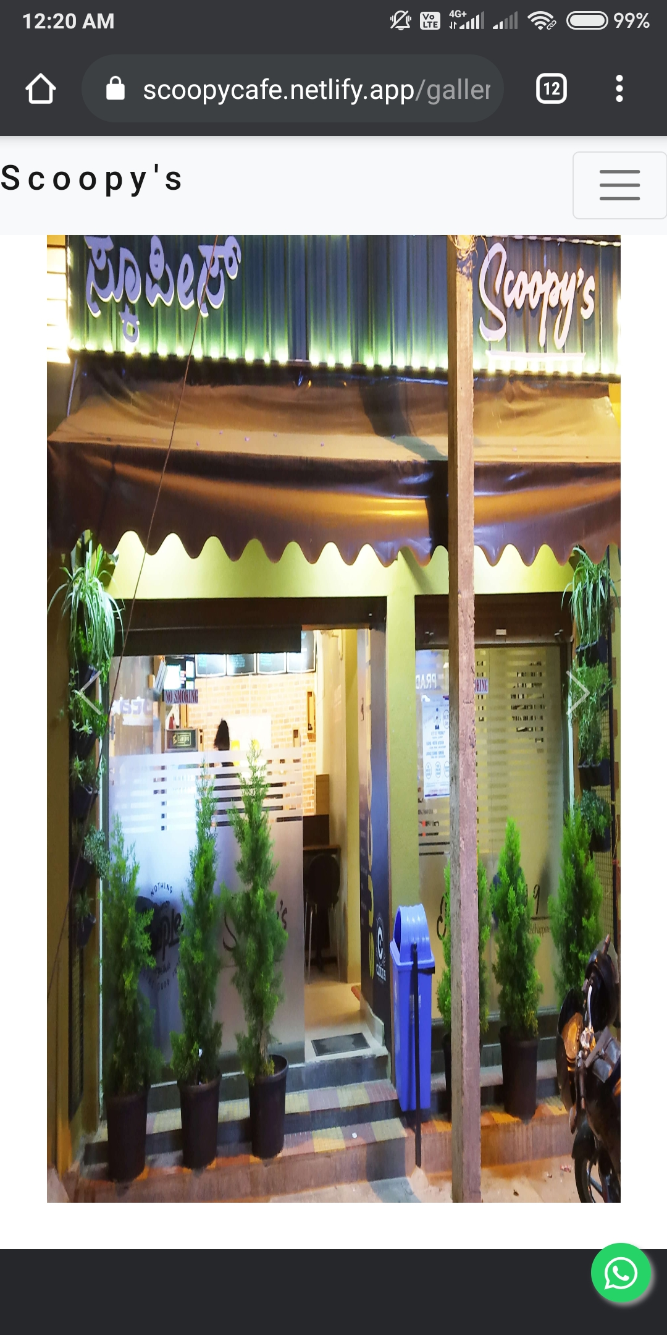
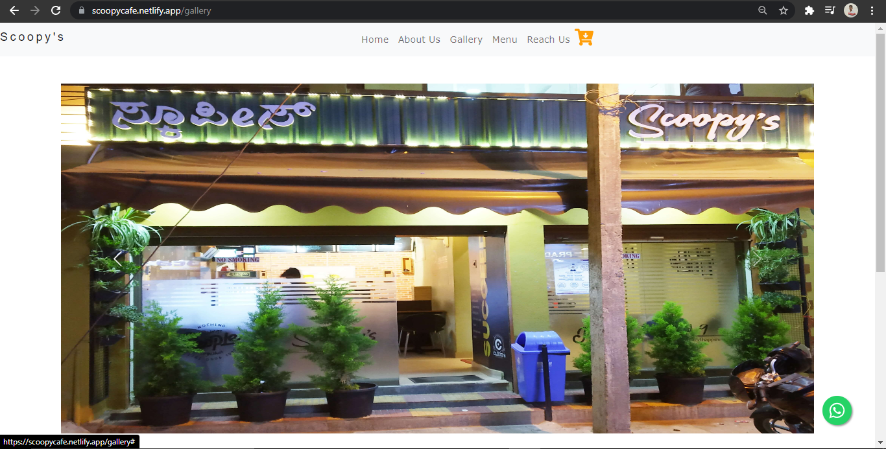
Snapshots

Slide 42
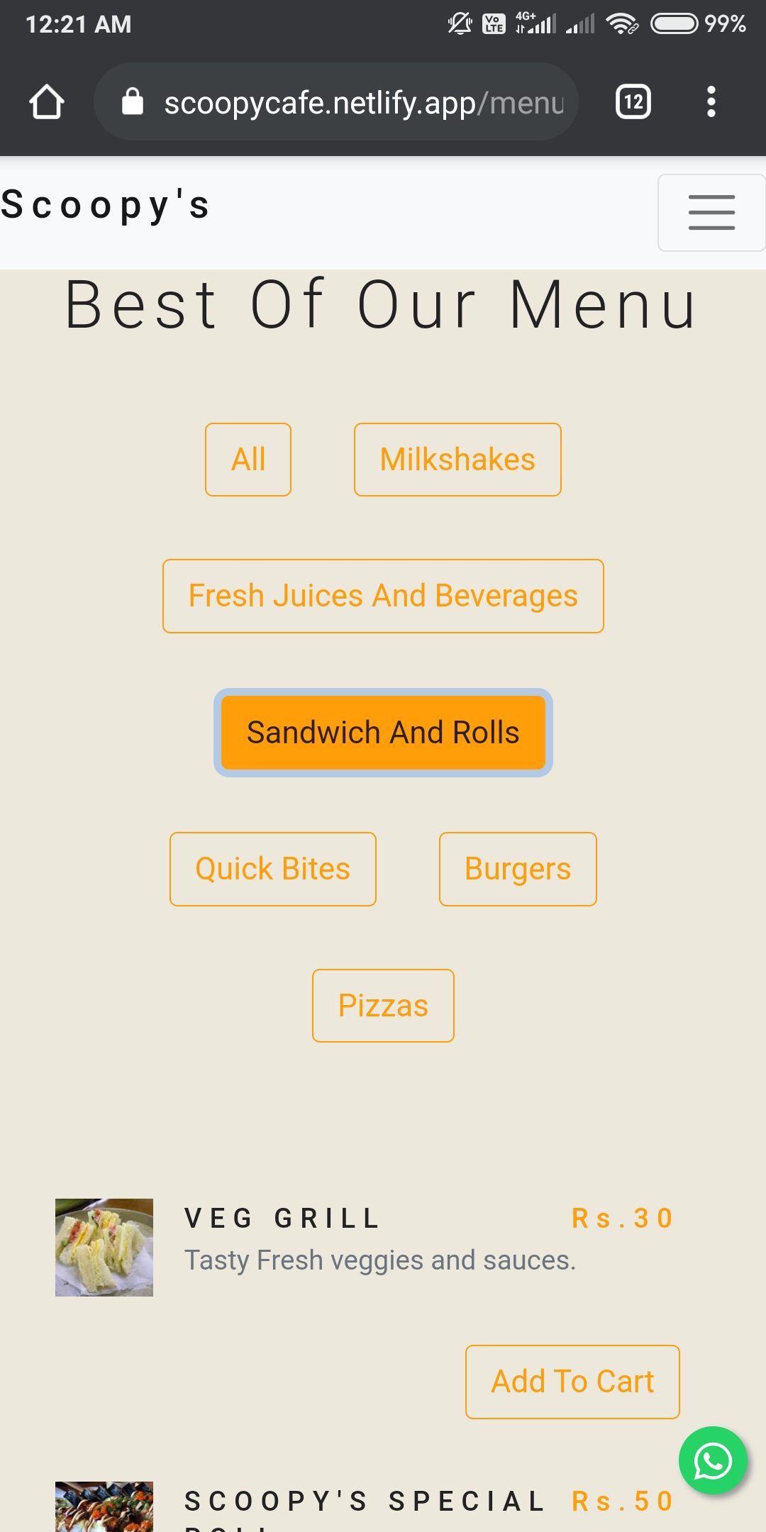
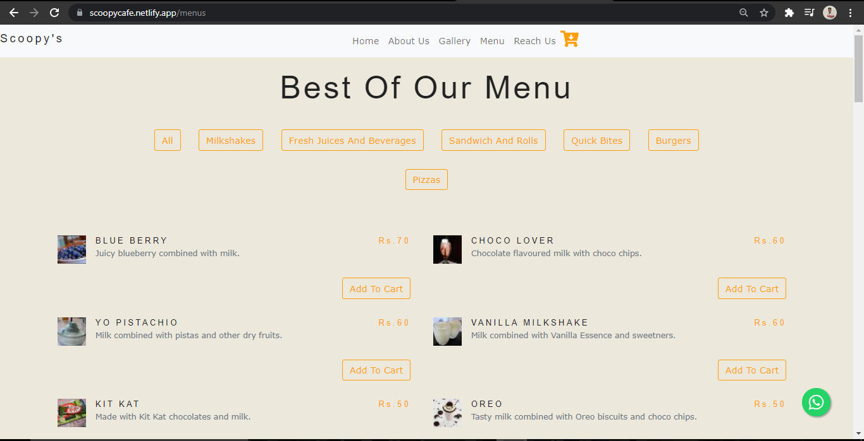
Snapshots

Slide 43
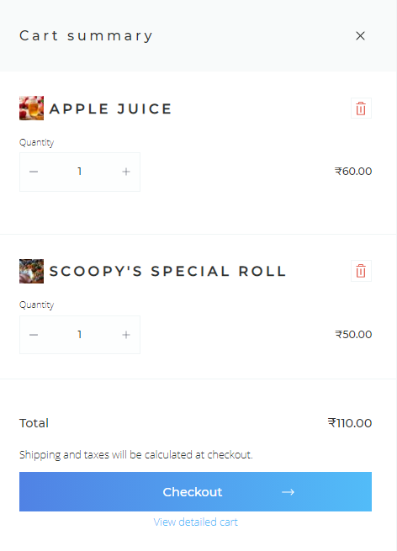
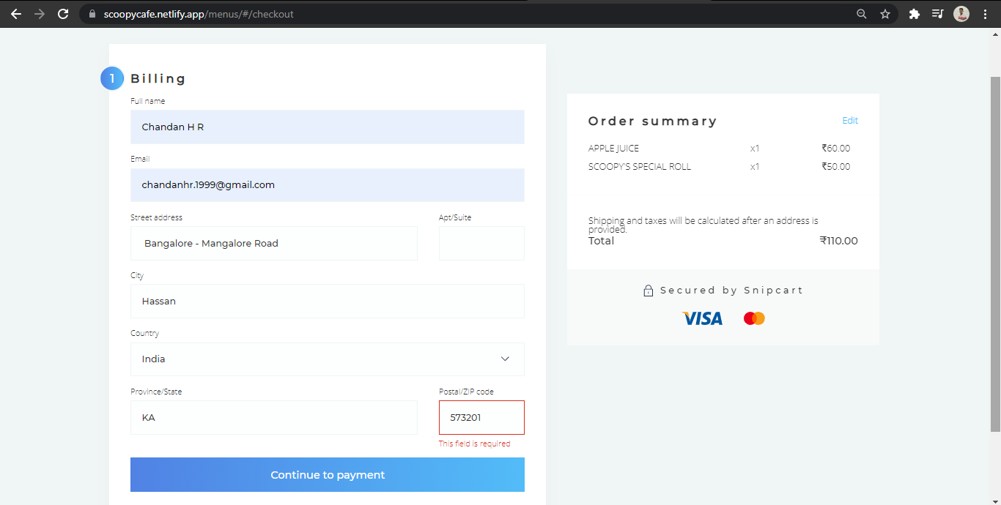
Snapshots

Slide 44
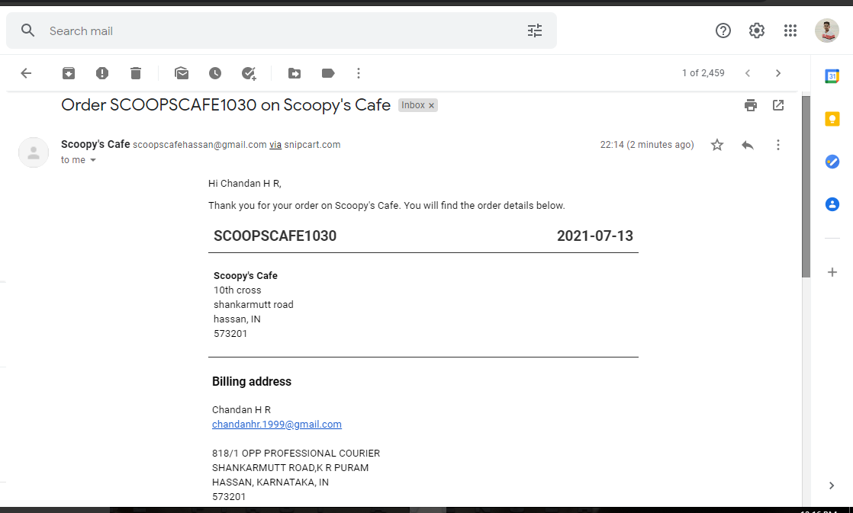
Snapshots

Slide 45

CONCLUSION
We have successfully implemented the web application for ‘Scoopy’s Cafe’ to help them during this pandemic. With the help of various platforms, links and tools, we have been able to provide a site which will be live soon and running on the web. We have been successful in our attempt to take care of the needs of both the user as well as the administrator during this COVID-19 pandemic where contactless service and social distancing is a must. Finally we hope that this project will go a long way in popularizing.

Slide 46

FUTURE SCOPE
In a nutshell, it can be summarized that the future scope of the project circles around some advance features such as,
Notifications need to be sent to customers for new arrivals or discount.
Alternate payment options can be integrated to this project.
Home-delivery options

Slide 47
REFERENCES
Jyoti Shetty, Deepika Dash, Akshaya Kumar Joish, Guruprasad C, ”Review Paper on Web Frameworks, Databases and Web Stacks “,Vol. 7 Issue 4 , April 2020 .
https://www.irjet.net/archives/V7/i4/IRJET-V7I41078
Sanchit Aggarwal,”Modern Web-Development using ReactJS “, International Journal of Recent Research Aspects ISSN: 2349- 7688, Vol. 5, Issue 1, March 2018 .
http://ijrra.net/Vol5issue1/IJRRA-05-01-27
Fernando Almeida,” The Role of Responsive Design in Web Development”, Volume 14, Number 2, December, 2017.
http://www.webology.org/index.html
Nodejs.org. 2020 NodeJS
https://nodejs.org/

Slide 48
REFERENCES
Gatsby Documentation
https://www.gatsbyjs.com/use-cases/technical-documentation
ReactJS Documentation
https://reactjs.org/docs/getting-started.html
Snipcart Documentation
https://docs.snipcart.com/v3
Formspree Documentation
https://formspree.io/formbutton/docs
Bootstrap Documentation
https://bootstrapdocs.com/v3.3.0/docs/getting-started
ReactJS Full Course
https://youtu.be/4UZrsTqkcW4
https://en.wikipedia.org/wiki/

Slide 49
Thank You!

